Slide 1

Presenter Instructions
RESOURCES
Contributors:
Sani Chabi Yo
Kamala Dasika
Ben Laplanche
Slack:
#sme-pcf-services
Drive:
Content/Services
Review in progress
Intended audience: App Dev
Duration:
Storyline
Problems
Application developers experience long waits and manual processes in order to get access to the services they need, as infrastructure is provisioned, installed and configured - all delaying their ability to deliver the features that the business and customers depend upon.
Developers want to use new open technologies such as MySQL, Cassandra and Kafka, rather than their legacy vendor locked in offerings, but encounter barriers to entry in the form of the speed at which they can deploy something for a trial and see if it meets their use case.
Solutions
A services marketplace to provide all of the tools and components that developers need to move fast and build awesome applications.
Send any feedback and deck customizations to syo@pivotal.io

Slide 2


PCF Services Overview
Name
Title
Contact info

Slide 3

AGENDA
Overview
Service Marketplace
Developer Experience
Q&A

Slide 4
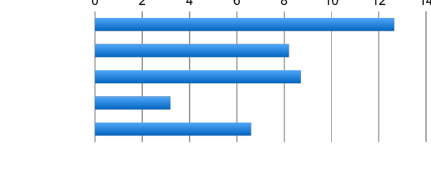
Productivity: Developer spend too much time waiting
0
2
4
6
8
10
12
14
Design and Coding
Brainstorming
Administrative Tasks
Managing Environments
Waiting for Test/Build
Task Breakdown
Average Hours / Week
Sources: “Electric Cloud LinkedIn Survey to software developers”
Notes:
Traditional CI/CD deployments setup with custom servers means that each app instance requires individual configuration and secured. This kicks off a whole set of checks and balances from your ops team. You have ticket-based manual provisioning. When you go to push an update, it’s too complex to automate and test automatically, so every update requires a sequence of manual steps and checks. You
As you can see in this survey of over a thousand developers, devs estimate that they spend a huge amount of time on administration and environment managing their environment, including 20% of their time waiting. So there are some obvious issues with
http://readwrite.com/2013/04/25/how-software-developers-really-spend-their-time

Slide 5
Enter Cloud Native
Distributed
Scalable
Automated
Replaceable
Anti-fragile
Iterative evolution of solution
DevOps
Continuous
Delivery
Cloud Native
Micro services
Containers
Optimized for Speed
Notes:
Cloud Native Apps are apps that bring together concepts like microservices, anti-fragile, 12-factor, stateless applications.
CLOUD NATIVE is the coming together of tools, frameworks and building modern software on a cloud infrastructure

Slide 6
How do Service fit into that model?
Professional Services for Agile, CI/CD
Cloud Native
Data Services
BDS
Services
Pivotal
Labs
Pivotal Cloud Foundry
PCF
Mobile
Services
Spring
Cloud
Services
Cloud Native
Mobile Services
Cloud Native
Application Framework

Slide 7

What is a Service?
Allows resources to be easily provisioned on-demand.
Typically middleware, frameworks, and other “components” necessary for applications.
Can be a persistent, stateful layer

Slide 8

2 types of Services
Managed – Fully integrated, with fully lifecycle management
User-Provided – Created and managed externally to the Platform.

Slide 9
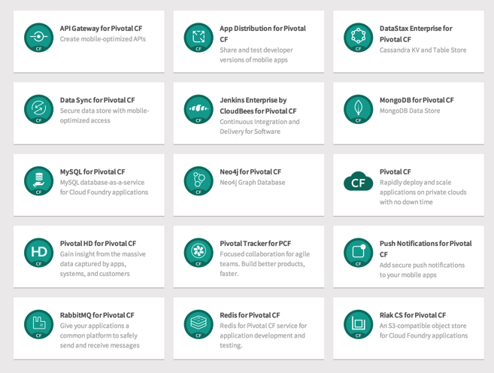
Managed Services
Managed Services are integrated with PCF by implementing a documented API.
A self-service catalog of databases, analytics and middleware technologies:
Production ready
Integrated lifecycle management
Managed credentials
Role-based access
Service Broker is a component which implements the Service API. Service brokers advertise a catalog of service offerings and service plans to Cloud Foundry.

Slide 10


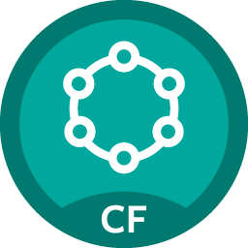




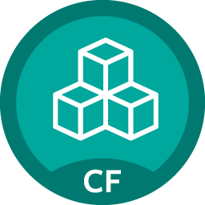











Pivotal Cloud Foundry Service
Mobile
Datastore
Other
Cloud-native
API Gateway
Redis
DataStax Cassandra
RabbitMQ
Config Server
Push Notifications
MySQL
GemFire
Jenkins Enterprise by CloudBees
Service Directory
Data Sync
Session state caching
PivotalHD (BETA)
Spring XD (BETA)
Circuit Breaker
App Distribution
Neo4j (BETA)
MongoDB (BETA)
Single Sign-on

Slide 11

Service Creation & Binding
DB
Service
credentials
CLI
create service (HTTP)
Cloud Controller
create service (HTTP)
Service
Broker
reserve resources
Data
Service
Router
bind service (HTTP)
bind service (HTTP)
obtain connection data
Runtime
Notes:
An application runs in a DEA, which is a droplet execution agent. The Cloud Controller orchestrates the routing and lifecycle of all DEAs in the pool. Routers manage application traffic. Health Manager reports mismatched application states to the CC. A service gateway provides an interface for services (native or external). A messaging bus manages all system communication. Apps are accessed directly through the router while web and CLI clients (e.g., vmc, STS) access Cloud Controller via RESTful services.

Slide 12
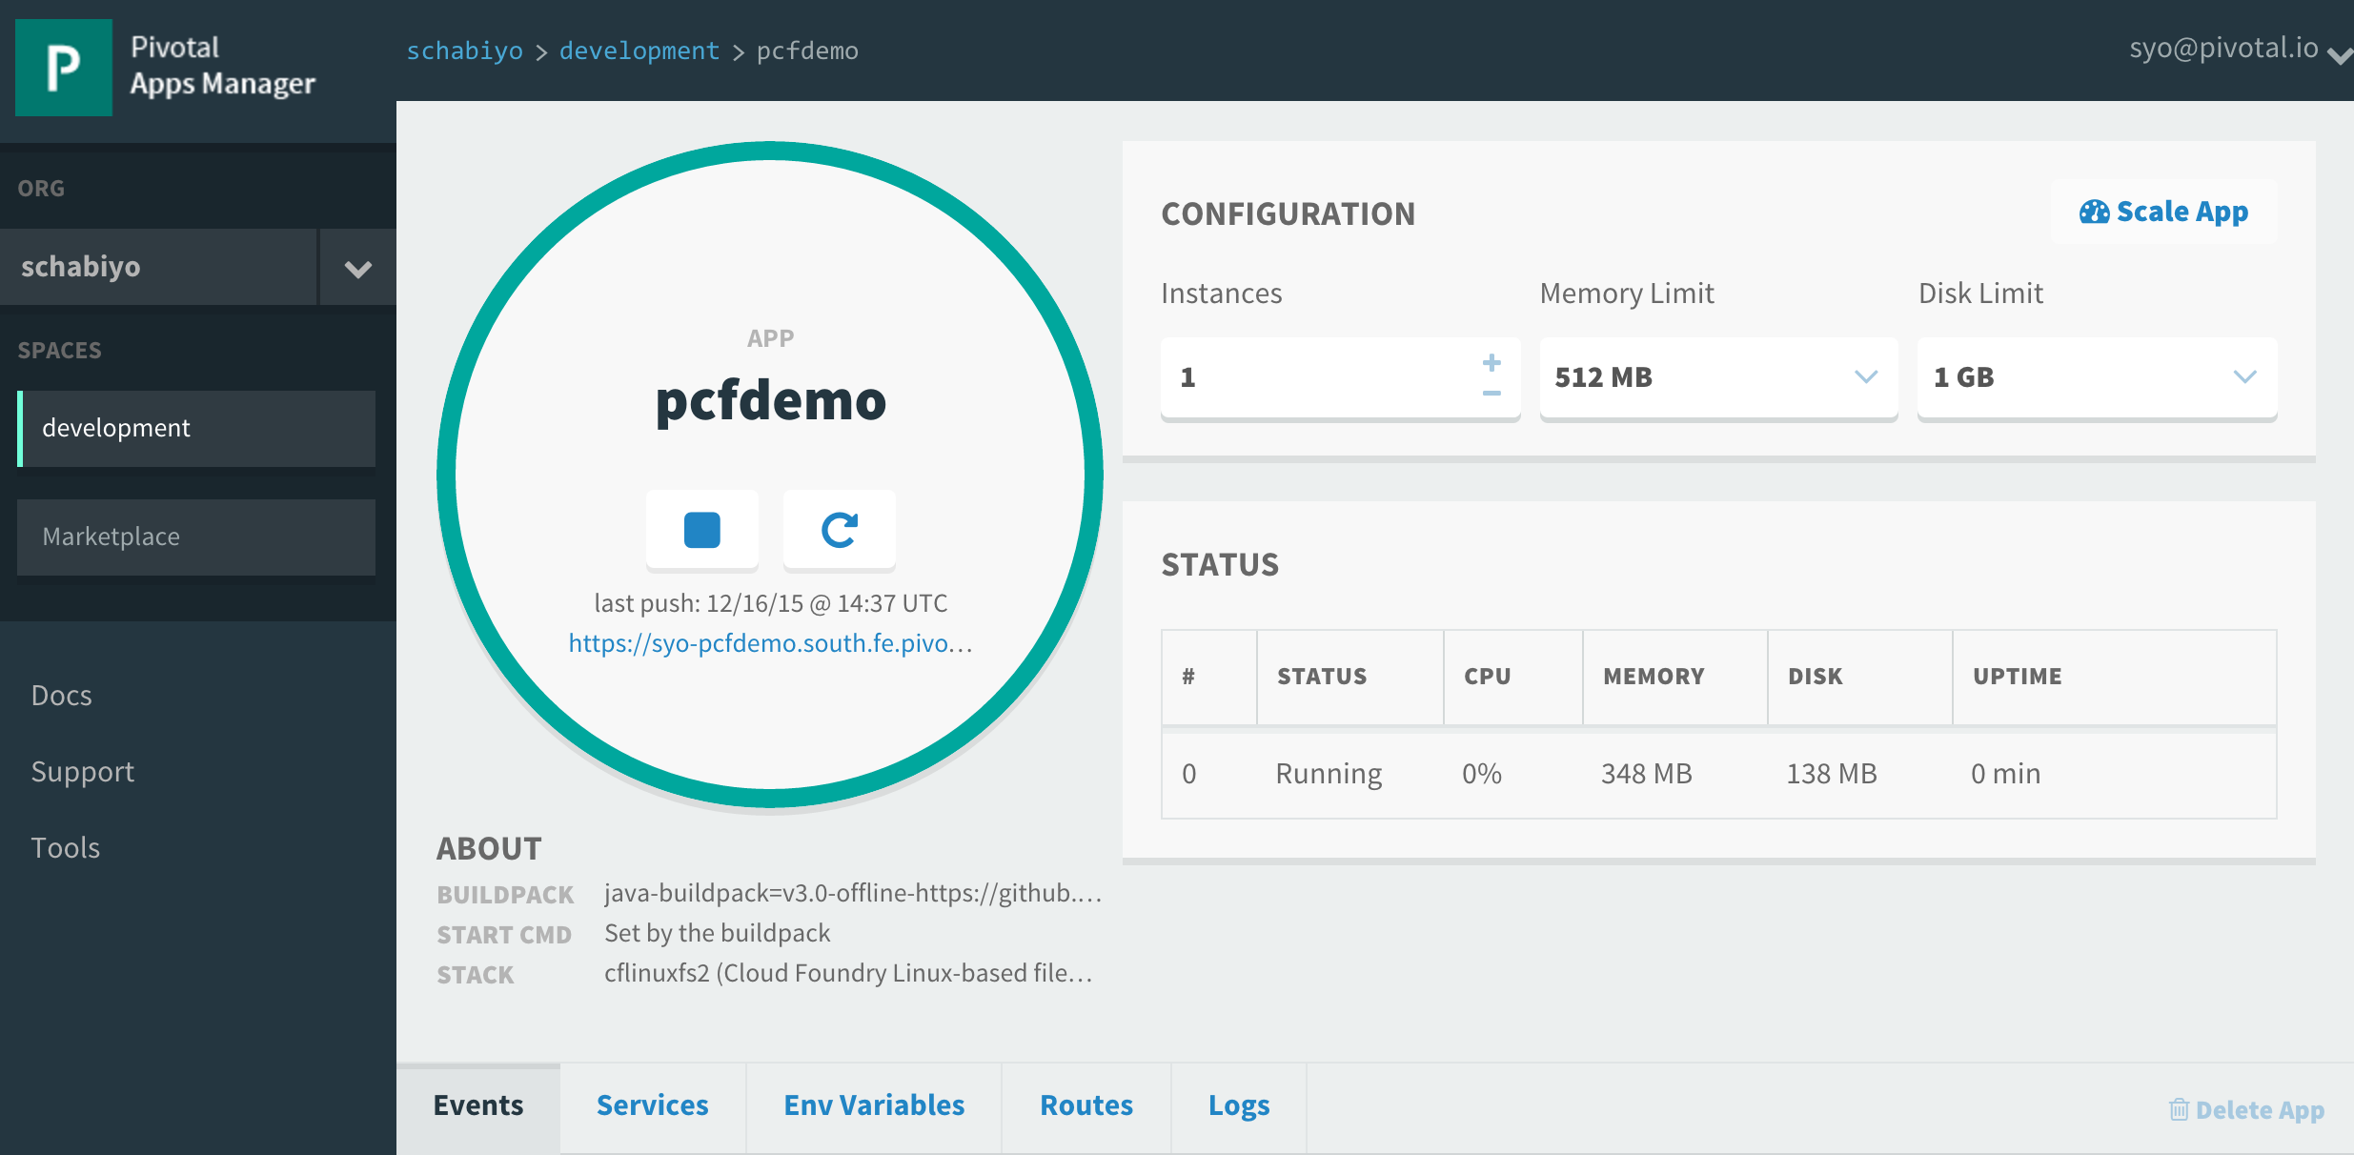
Example: Service Creation & Binding
Click on "Marketplace"
Create Service
Bind service
Restart App
Verify

Slide 13
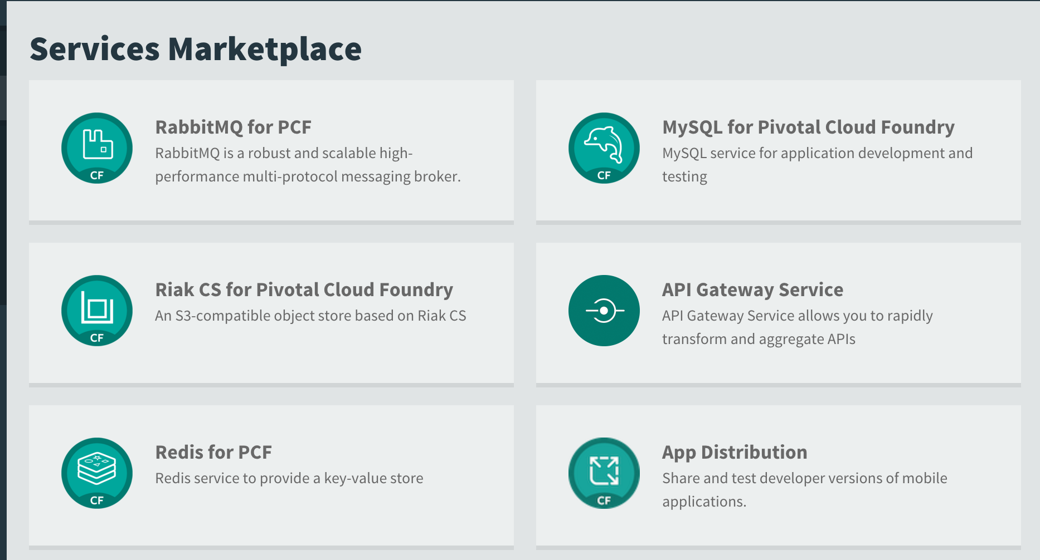
Example: Service Creation & Binding
Choose ”RabbitMQ for PCF"
Create Service
Bind service
Restart App
Verify

Slide 14
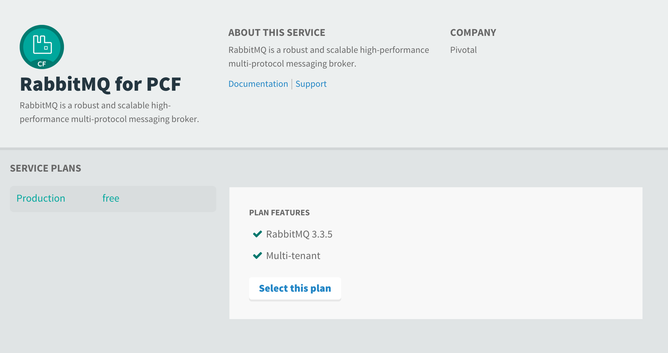
Example: Service Creation & Binding
Select the free plan
Create Service
Bind service
Restart App
Verify

Slide 15
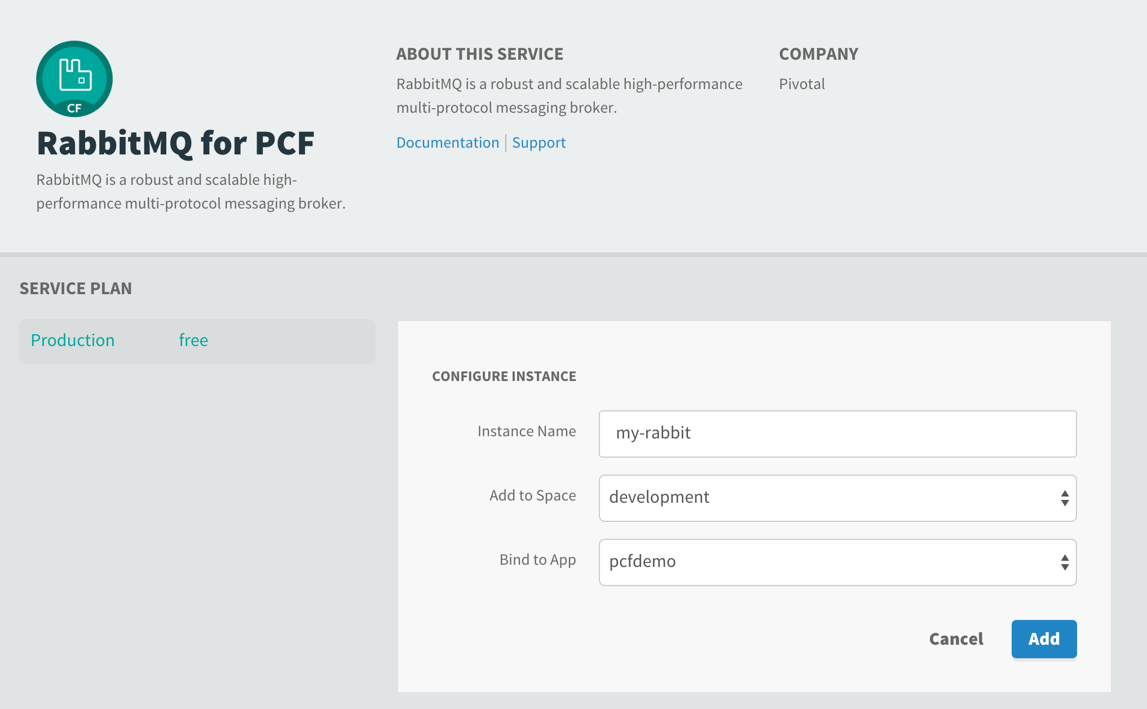
Example: Service Creation & Binding
Give it a name and bind it to your application
Create Service
Bind service
Restart App
Verify

Slide 16
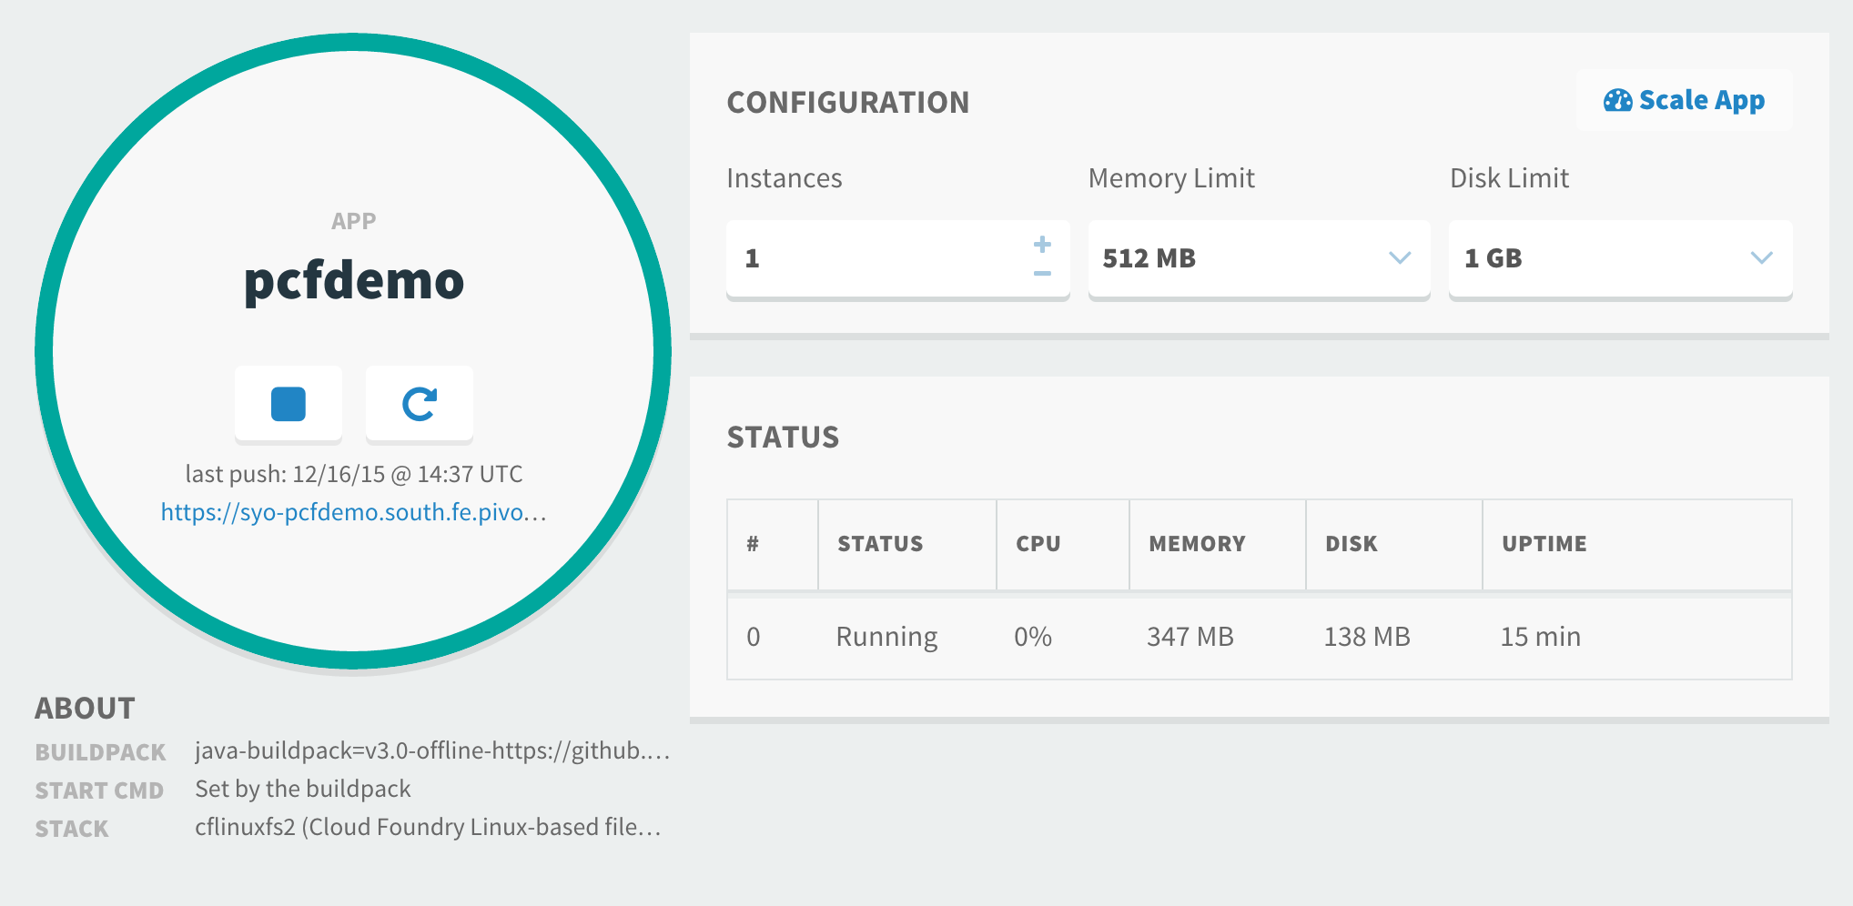
Example: Service Creation & Binding
Create Service
Bind service
Restart App
Verify

Slide 17
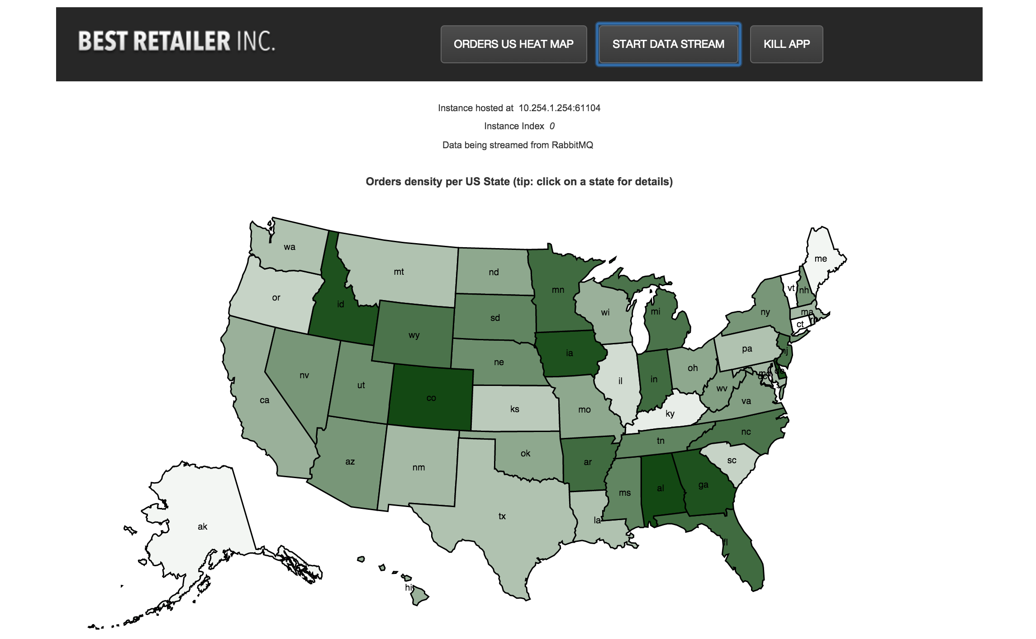

Slide 18
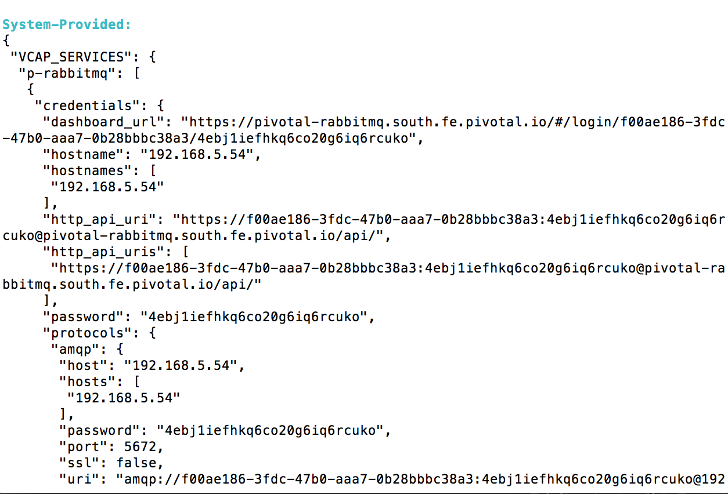
Example: Service Creation & Binding
$ cf env pcfdemo
Create Service
Bind service
Restart App
Verify

Slide 19
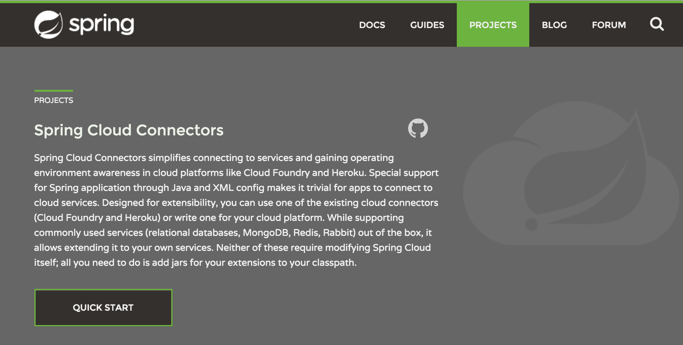
The magic is in Spring Cloud
Full details can be found here http://projects.spring.io/spring-cloud

Slide 20


Spring Cloud Connectors modules
Cloud Foundry Connector
Heroku Connector
Core
Spring Service Connector

Slide 21
User-Provided Service
User-provided - A user-provided service is simply a list of connection parameters that are stored in the platform and provided to an application when it binds to the service.
User-provided services are useful for quickly getting parameters to an application, without having to create a service broker and registering with it the platform. They are also helpful for services that will probably only be used once or twice.
Applications connect to the same instance.
User-provided services are created using the CF CLI’s create-user-provided-service command, which takes an arbitrary set of key/value pairs as an argument.
> cf create-user-provided-service my-old-db –p ‘{“user”:”admin”,”password”:”pwd”}’
Full instructions can be found here https://docs.pivotal.io/pivotalcf/devguide/services/user-provided.html

Slide 22
Q&A

Slide 24
Slide Appendix

